Slide 1
Stack , Dictionary and Sets using STL in C++

Slide 2
What is C++ STL(Standard Template Library)?
The Standard Template Library (STL) is a set of C++ template classes to provide common programming data structures and functions such as lists, stacks, arrays, etc.
STL is the library of Generic classes and Function
Benefits of the STL is that it provides a way to write generic, reusable code that can be applied to different data types
Components of STL
Containers = Stores Date , Use Templates classes
Algorithms = Use Template Function
Iterators = Object points to an elements in a containers, connects Algorithm with containers

Slide 3
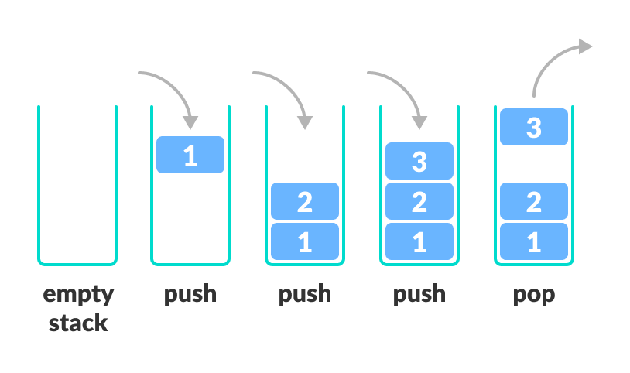
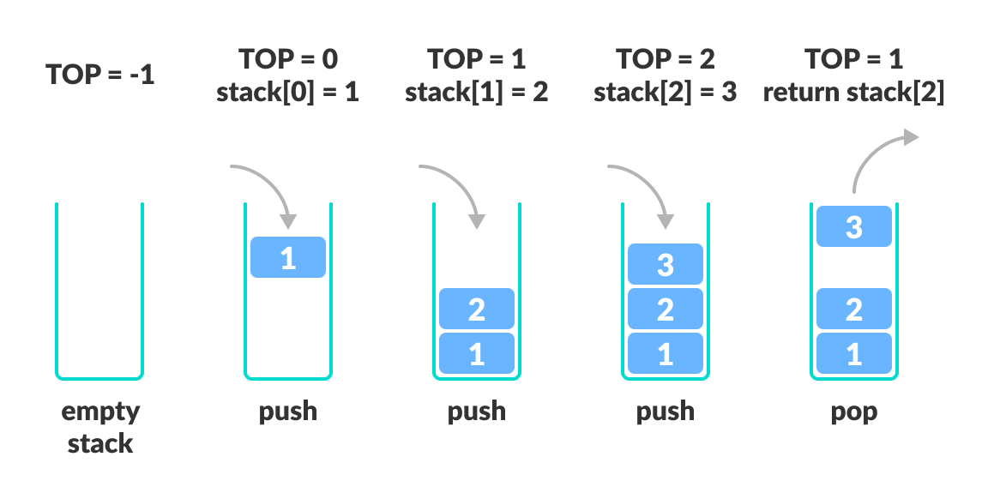
Stack:
A stack is a linear data structure that follows the principle of Last In First Out (LIFO). This means the last element inserted inside the stack is removed first.
In programming terms, putting an item on top of the stack is called push and removing an item is called pop.
Fig : Stack Push and Pop Operations
Fig : Working of Stack Data Structure

Slide 4
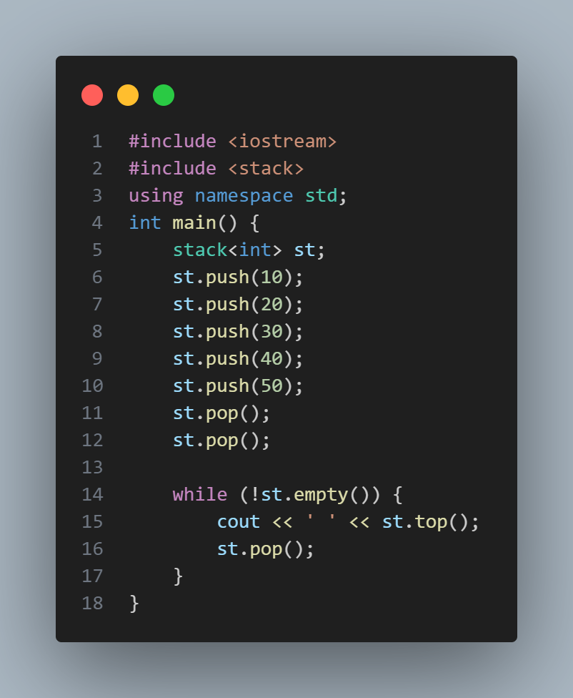

Stack implementation using STL

Slide 5
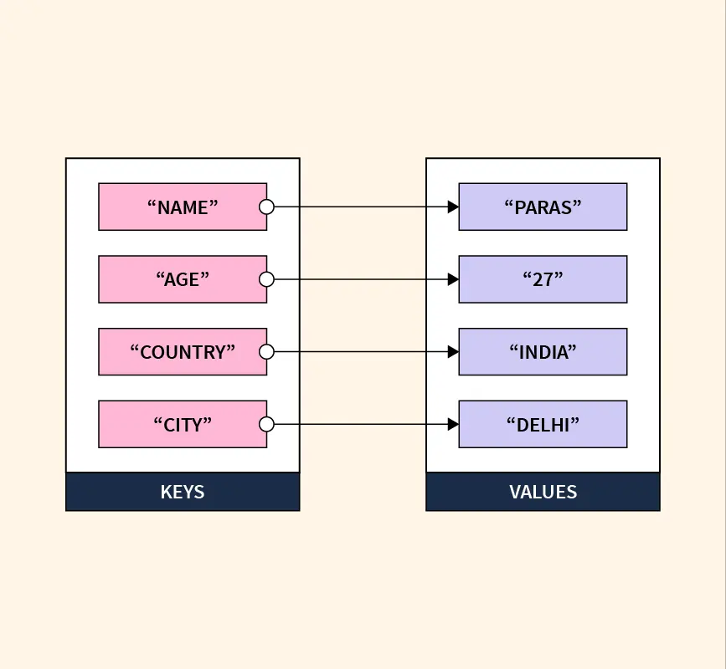
Dictionary
In C++, we don’t have a default data structure like a dictionary as we do in other programming languages such as Python. However, we can achieve similar functionality using data structures like maps in C++.
A dictionary is a data structure that enables users to store data in the form of key-value pairs, where each key must be unique.
Fig : Dictionary in Data Structure

Slide 6
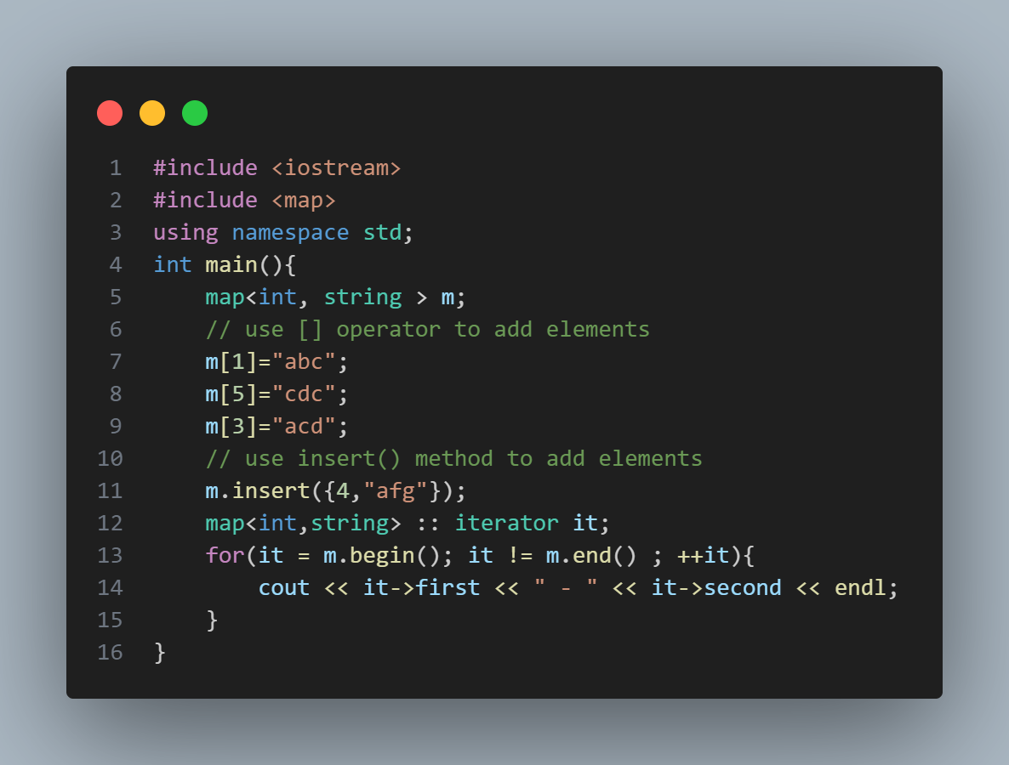
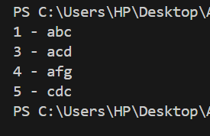
Dictionary(maps) implementation using STL

Slide 7
C++ Sets
Sets are STL containers that store unique elements of the same type in a sorted manner.
As the value of every element in a set is unique, the value itself acts as the key for identifying the element.
The std::set class is the part of C++ Standard Template Library (STL) and it is defined inside the <set> header file.

Slide 8
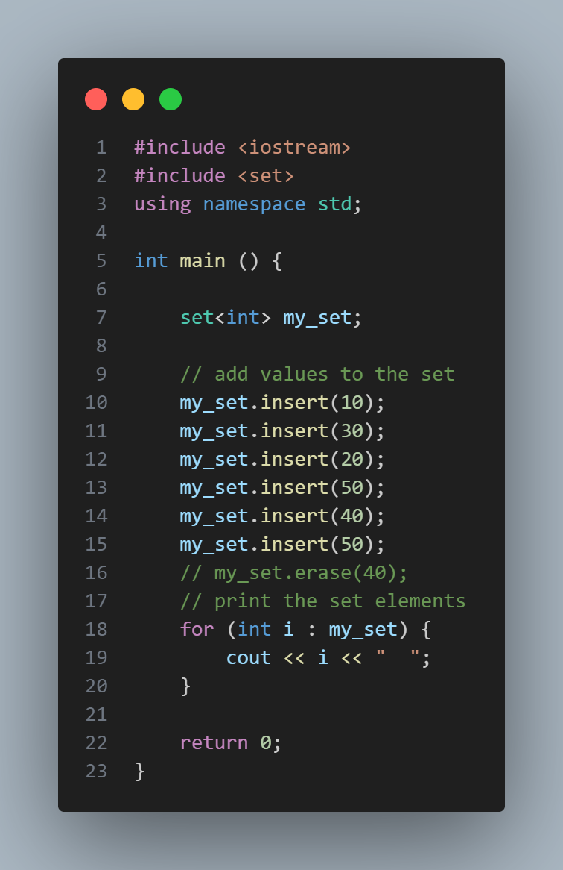
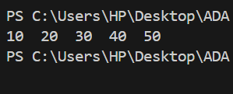
SETS implementation using STL

Slide 9
Thank You

